Slide 1
Matrix Algebra
CHARACTERIZATIONS OF INVERTIBLE MATRICES

Slide 2
IT’S ALL ABOUT THE PIVOTS
Let A be an matrix. On the following slides, each statement is true if and only if one of the following holds:
There is a pivot in every row of A.
There is a pivot in every column of A.
Decide which.

Slide 3

IT’S ALL ABOUT THE PIVOTS
The equation has only the trivial solution.
There is a pivot in every column of A.
The equation has a solution for every b
in .
There is a pivot in every row of A.
$$ℝ^{m}$$

Slide 4

IT’S ALL ABOUT THE PIVOTS
The columns of A span .
There is a pivot in every row of A.
The columns of A are linearly independent.
There is a pivot in every column of A.
$$ℝ^{m}$$

Slide 5
IT’S ALL ABOUT THE PIVOTS
The linear transformation is one-to-one.
There is a pivot in every column of A.
The linear transformation is onto.
There is a pivot in every row of A.

Slide 6
IT’S ALL ABOUT THE PIVOTS
Notice that when m = n,
There is a pivot in every column of A
if and only if
there is a pivot in every row of A.

Slide 7
IT’S ALL ABOUT THE PIVOTS
A is an invertible matrix.
A has a pivot in every row and column.
A is row equivalent to the identity matrix.
A has a pivot in every row and column.
is invertible.
A has a pivot in every row and column.

Slide 8
IT’S ALL ABOUT THE PIVOTS
There is an matrix C such that CA = I .
A has a pivot in every row and column.
There is an matrix D such that AD = I .
A has a pivot in every row and column.

Slide 9
THE INVERTIBLE MATRIX THEOREM
Let A be an matrix. The following are equivalent:
The matrix A is an invertible matrix.
The matrix A is row equivalent to the identity matrix.
A has n pivot positions.
The equation has only the trivial solution.
The columns of A form a linearly independent set.

Slide 10




THE INVERTIBLE MATRIX THEOREM
The linear transformation is one-to-one.
The equation has at least one solution for each b in .
The columns of A span .
The linear transformation maps onto .
There is an matrix C such that .
There is an matrix D such that .
A^{T} is an invertible matrix.
$$ℝ^{n}$$
$$ℝ^{n}$$
$$ℝ^{n}$$
$$ℝ^{n}$$

Slide 11
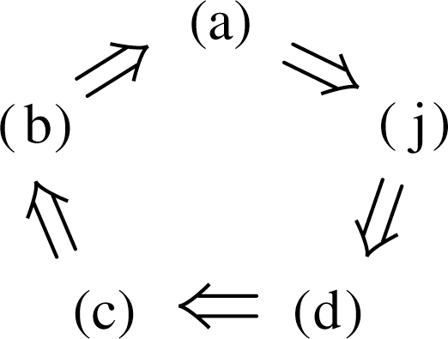
THE INVERTIBLE MATRIX THEOREM
The textbook contains a careful proof of the relationship between each statement for the interested reader.
For example, the proof will establish the “circle” of implications as shown in the following figure.
If any one of these five statements is true, then so are the others, as each one implies the next.

Slide 12
THE INVERTIBLE MATRIX THEOREM
Next, because works for D.
Also, and .
So (k) and (g) are linked to the circle.
Further, (g), (h), and (i) are equivalent for any matrix.
Thus, (h) and (i) are linked through (g) to the circle.
Since (d) is linked to the circle, so are (e) and (f), because (d), (e), and (f) are all equivalent for any matrix A.
Finally, and .
This completes the proof.

Slide 13
THE INVERTIBLE MATRIX THEOREM
Additionally, whenever A is invertible:
is invertible and .
The Invertible Matrix Theorem divides the set of all
matrices into two disjoint classes:
the invertible (nonsingular) matrices,
and
the noninvertible (singular) matrices.

Slide 14
THE INVERTIBLE MATRIX THEOREM
Each statement in the theorem describes a property of every invertible matrix.
The negation of a statement in the theorem describes a property of every singular matrix.
For instance, an singular matrix is not row equivalent to I_{n}, does not have n pivot position, and has linearly dependent columns.

Slide 15

THE INVERTIBLE MATRIX THEOREM
Example 1: Use the Invertible Matrix Theorem to decide if A is invertible:
Solution:
$$A∼\left[\begin{matrix}1 & 0 & −2 \\ 0 & 1 & 4 \\ 0 & −1 & −1\end{matrix}\right]∼\left[\begin{matrix}1 & 0 & −2 \\ 0 & 1 & 4 \\ 0 & 0 & 3\end{matrix}\right]$$

Slide 16
THE INVERTIBLE MATRIX THEOREM
So A has three pivot positions and hence is invertible, by the Invertible Matrix Theorem, statement (c).
The Invertible Matrix Theorem applies only to square matrices.
For example, if the columns of a matrix are linearly independent, we cannot use the Invertible Matrix Theorem to conclude anything about the existence or nonexistence of solutions of equation of the form .

Slide 17
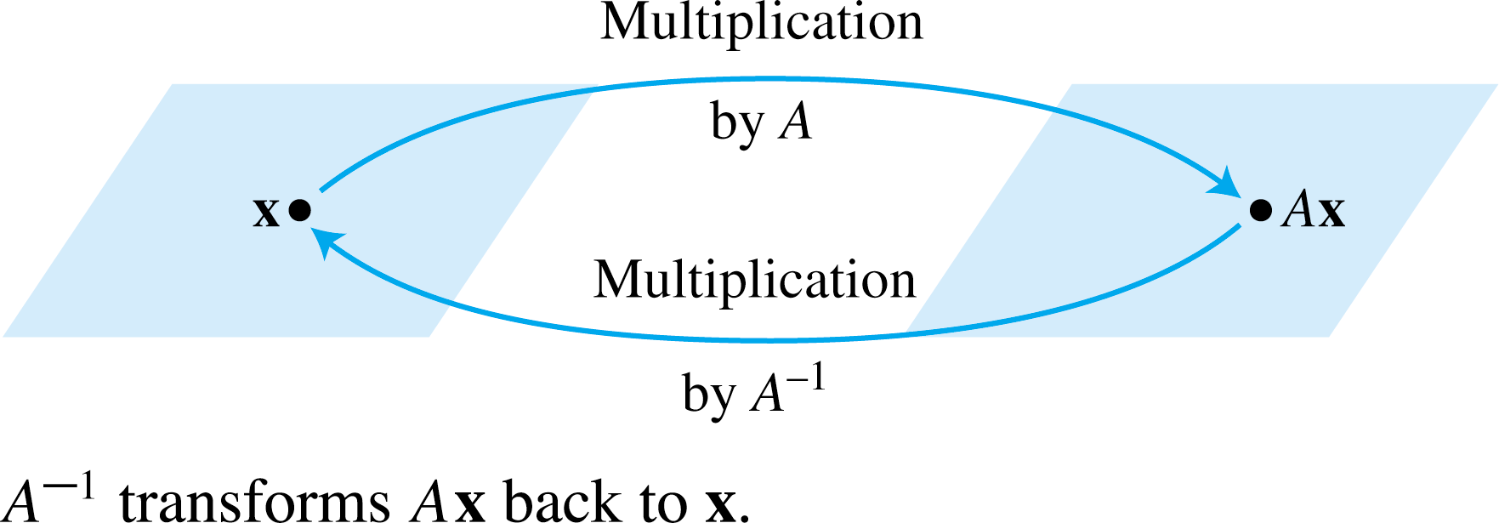
INVERTIBLE LINEAR TRANSFORMATIONS
Matrix multiplication corresponds to composition of linear transformations.
When a matrix A is invertible, the equation can be viewed as a statement about linear transformations. See the following figure.

Slide 18





INVERTIBLE LINEAR TRANSFORMATIONS
$$T{:ℝ}^{n}{→}ℝ^{n}$$
A linear transformation is said to be invertible if there exists a function such that
for all x in ----(1)
for all x in ----(2)
Theorem 9: Let be a linear transformation and let A be the standard matrix for T. Then T is invertible if and only if A is an invertible matrix. In that case, the linear transformation S given by is the unique function satisfying equation (1) and (2).
$$S{:ℝ}^{n}{→}ℝ^{n}$$
$$ℝ^{n}$$
$$ℝ^{n}$$
$$T{:ℝ}^{n}{→}ℝ^{n}$$

Slide 19


INVERTIBLE LINEAR TRANSFORMATIONS
Proof: Suppose that T is invertible.
Then (2) shows that T is onto , for if b is in and
, then , so each b is in the range of T.
Thus A is invertible, by the Invertible Matrix Theorem, statement (i).
Conversely, suppose that A is invertible, and let
. Then, S is a linear transformation, and S satisfies (1) and (2).
For instance, .
Thus, T is invertible.
$$ℝ^{n}$$
$$ℝ^{n}$$

